Slide 1
Prim’s and Kruskal's Algorithm

Slide 2
What are trees in undirected graphs?
We are familiar with a rooted directed tree, such as:
Binary search tree
Heap
They look like:
You know which one the root is
Who the parent is
Who the children are
3
5
6
4
2

Slide 3
What are trees in undirected graphs?
However, in undirected graphs, there is another definition of trees
Tree
A undirected graph (V, E), where E is the set of undirected edges
All vertices are connected
|E|=|V|-1
3
5
6
4
2

Slide 4
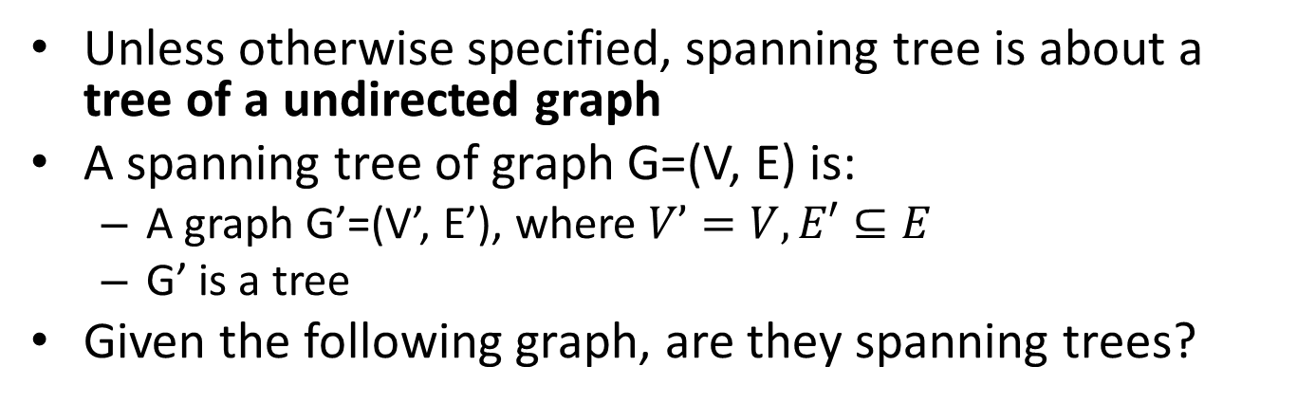
What is a spanning tree?
Unless otherwise specified, spanning tree is about a tree of a undirected graph
A spanning tree of graph G=(V, E) is:
A graph G’=(V’, E’), where $V’=V, E′⊆E$
G’ is a tree
Given the following graph, are they spanning trees?
b
c
d
a
i
e
h
g
f

Slide 5

What is a spanning tree?
Given the following graph, are they spanning trees?
b
c
d
a
i
e
h
g
f
Is the red sub graph a tree?
Yes
Is the red sub graph a spanning tree?
No$. V’ ≠V$

Slide 6

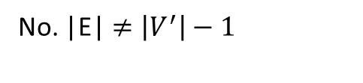
What is a spanning tree?
Given the following graph, are they spanning trees?
b
c
d
a
i
e
h
g
f
Is the red sub graph a tree?
No. |E|$≠\left|V^{′}\right|−1$
Is the red sub graph a spanning tree?
No$.$It is not a tree.

Slide 7
What is a spanning tree?
Given the following graph, are they spanning trees?
b
c
d
a
i
e
h
g
f
Is the red sub graph a tree?
No. Vertices are not all connected
Is the red sub graph a spanning tree?
No$.$It is not a tree.

Slide 8
What is a spanning tree?
Given the following graph, are they spanning trees?
b
c
d
a
i
e
h
g
f
Is the red sub graph a tree?
Yes
Is the red sub graph a spanning tree?
Yes

Slide 9
What is a spanning tree?
Given the following graph, are they spanning trees?
b
c
d
a
i
e
h
g
f
Is the red sub graph a tree?
Yes
Is the red sub graph a spanning tree?
Yes
There could be more than one spanning trees

Slide 10
What is a minimum spanning tree?
When edges are weighted
A minimum spanning tree of G is:
A spanning tree of G
With a minimum sum of a edge weights sum among all spanning trees
b
8
c
7
d
4
9
2
11
14
a
i
4
e
7
6
8
10
h
g
f
1
2

Slide 11
What is a minimum spanning tree?
Spanning trees:
b
8
c
7
d
4
9
The weight sum of this spanning tree?
2
11
14
a
i
4
e
48
7
6
8
10
h
g
f
1
2
b
c
d
The weight sum of this spanning tree?
4
9
2
11
14
47
a
i
4
e
7
6
8
10
h
g
f
1
2

Slide 12
What is a minimum spanning tree?
Spanning trees:
b
8
c
7
d
4
9
The weight sum of this spanning tree?
2
11
14
a
i
4
e
37
7
6
8
10
h
g
f
1
2
b
8
c
7
d
The weight sum of this spanning tree?
4
9
2
11
14
37
a
i
4
e
7
6
8
10
These 2 are minimum spanning trees since there is no spanning tree with a smaller total weight
h
g
f
1
2

Slide 13
Minimum spanning tree problem
Minimum spanning tree (MST) problem: given a undirected graph G, find a spanning tree with the minimum total edge weights.
There are 2 classic greedy algorithms to solve this problem
Kruskal’s algorithm
Prim’s algorithm

Slide 14
Minimum spanning tree problem
A application example of MST in computer network
What if PC3 wants to communicate with PC7?
By a routing protocol:
PC3 broadcasts this requirement to PC2, PC4
PC2 broadcasts it to PC1, PC5
PC1 broadcasts it to PC5, PC6
…
PC5 broadcasts it to PC2
At least, a package is in a deadlock: PC2->PC1->PC5-PC2->PC1-> …………….
PC1
PC2
PC3
PC6
PC5
PC4
Find and use a MST can solve this problem, since there is no cycle

Slide 15
Minimum spanning tree problem
The MST algorithm can be considered as choose |V|-1 edges from E to form a minimum spanning tree
Both Kruskal’s algorithm and Prim’s algorithm proposed a greedy choice about how to choose a edge
They have greedy choice property because of textbook Corollary 23.2

Slide 16
Kruskal’s algorithm
Input: G=(V, E)
Output: a minimum spanning tree (V, A)
Kruskal (G=(V, E))
Set each vertices in V as a vertex set;
Set A as an empty set;
while (there are more than 1 vertex set){
Add a smallest edge (u, v) to A where u, v are not in the same set;
Merge the set contains u with the set contains v;
}
In most of the implementations, edges are sorted on weights at the beginning, and then scan them once
The running time = O(|E|lg|V|)

Slide 17

Kruskal’s algorithm
Kruskal (G=(V, E))
Set each vertices in V as a vertex set;
Set A as an empty set;
while (there are more than 1 vertex set){
Add a smallest edge (u, v) to A where u, v are not in the same set;
Merge the set contains u with the set contains v;
}
Edge | Weight
(h, g) | 1
(i, c) | 2
(g, f) | 2
(c, f) | 4
(a, b) | 4
(i, g) | 6
(h, i) | 7
(c, d) | 7
(a, h) | 8
(b, c) | 8
(d, e) | 9
(e, f) | 10
(b, h) | 11
(d, f) | 14
b
8
c
7
d
4
9
2
11
14
a
i
4
e
7
6
8
10
h
g
f
1
2
Total weight: 37

Slide 18
Prim’s algorithm
Input: G=(V, E)
Output: a minimum spanning tree (V, A)
Prim(G=(V, E))
Set A as an empty set;
Choose a vertex as the current MST;
while (not all the vertices are added into the MST){
Choose the smallest edge crossing current MST vertices and other vertices, and put it to MST ;
}
The running time = O(|E|lg|V|)

Slide 19
Prim’s algorithm
Prim(G=(V, E))
Set A as an empty set;
Choose a vertex as the current MST;
while (not all the vertices are added into the MST){
Choose the smallest safe edge, and put it to MST;
}
b
8
c
7
d
4
9
2
11
14
a
i
4
e
7
6
8
10
h
g
f
1
2
Total weight: 37

Slide 20
Summary
Prim’s algorithm and Kruskal’s algorithm have the same asymptotically running time

Slide 21
Kruskal's Algorithm
Sometimes greedy algorithms can also be optimal
Simple greedy optimal algorithm for MST
Start with an empty graph
Repeatedly add the next smallest edge from E that does not produce a cycle
How might we test for cycles and what would the complexity be?
Notes:
Crew-skal
Just like with our top down, we had to decide if it was connected with Kruskals we have to
know when there is not a cycle created (without having to do a full dfs each time). Kruskal's is a nice alg to do that.
V*dfs (and check for backeges). V*E – too slow

Slide 22
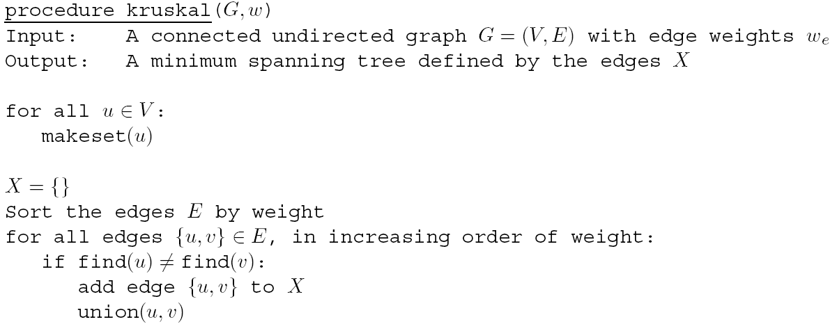
Kruskal's Algorithm
find(u) = find(v) if u and v are in the same set, which means they are in the same connected component
Why not union nodes that are already in the same set?
Represents nodes in disjoint sets
makeset(u): create a singleton set containing just u
find(u): to which set does u belong?
union(u,v): merge the sets containing u and v
Notes:
Save complexity for later slide
Give intuition of union/cycles

Slide 23
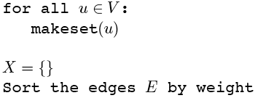
Kruskal’s Algorithm
Make a disjoint set for each vertex
1
2
1
2
3
{1}{2}{3}{4}{5}{6}{7}
6
5
4
4
6
3
8
4
5
6
7
4
3
7
Notes:
Each vertex goes into a separate connected component.
We'll show X on the graph (colored edges), Each color will represent a connected component

Slide 24
Kruskal’s Algorithm
Sort edges by weight
1
2
1
2
3
1: {1,2}
{1}{2}{3}{4}{5}{6}{7}
2: {2,3}
6
5
4
4
6
3: {4,5}
3
8
3: {6,7}
4
5
6
4: {1,4}
4: {2,5}
7
4
3
4: {4,7}
5: {3,5}
7
Notes:
Goal: Visually walk through Kruskal’s algorithm running on this simple graph. This simple enumerates the steps
starting with the sorting.

Slide 25
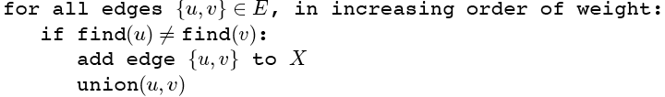
Kruskal’s Algorithm
Add first edge to X if no cycle created
1
2
1
2
3
1: {1,2}
{1}{2}{3}{4}{5}{6}{7}
2: {2,3}
6
5
4
4
6
3: {4,5}
3
8
3: {6,7}
4
5
6
4: {1,4}
4: {2,5}
7
4
3
4: {4,7}
5: {3,5}
7
Notes:
Add the edge with the lowest cost to the solution set X which does not create a cycle.

Slide 26
Kruskal’s Algorithm
Merge vertices in added edges
1
2
1
2
3
1: {1,2}
{1,2}{3}{4}{5}{6}{7}
2: {2,3}
6
5
4
4
6
3: {4,5}
3
8
3: {6,7}
4
5
6
4: {1,4}
4: {2,5}
7
4
3
4: {4,7}
5: {3,5}
7
Notes:
The two vertices that are in the edge are merged into the same connected component

Slide 27
Kruskal’s Algorithm
Process each edge in order
1
2
1
2
3
1: {1,2}
{1,2}{3}{4}{5}{6}{7}
2: {2,3}
{1,2,3}{4}{5}{6}{7}
6
5
4
4
6
3: {4,5}
3
8
3: {6,7}
4
5
6
4: {1,4}
4: {2,5}
7
4
3
4: {4,7}
5: {3,5}
7
Notes:
The next following slides show who each edge is added to T. The issue of always merging separate connected
Components is delayed until we try to add an edge that creates a cycle.

Slide 28
Kruskal’s Algorithm
1
2
1
2
3
1: {1,2}
{1,2}{3}{4}{5}{6}{7}
2: {2,3}
{1,2,3}{4}{5}{6}{7}
6
5
4
4
6
3: {4,5}
{1,2,3}{4,5}{6}{7}
3
8
3: {6,7}
4
5
6
4: {1,4}
4: {2,5}
7
4
3
4: {4,7}
5: {3,5}
7
Note that each set is a connected component of G
Notes:
different color for each non-singleton set/connected component

Slide 29
Kruskal’s Algorithm
1
2
1
2
3
1: {1,2}
{1,2}{3}{4}{5}{6}{7}
2: {2,3}
{1,2,3}{4}{5}{6}{7}
6
5
4
4
6
3: {4,5}
{1,2,3}{4,5}{6}{7}
3
8
3: {6,7}
{1,2,3}{4,5}{6,7}
4
5
6
4: {1,4}
4: {2,5}
7
4
3
4: {4,7}
5: {3,5}
7

Slide 30
Kruskal’s Algorithm
1
2
1
2
3
1: {1,2}
{1,2}{3}{4}{5}{6}{7}
2: {2,3}
{1,2,3}{4}{5}{6}{7}
6
5
4
4
6
3: {4,5}
{1,2,3}{4,5}{6}{7}
3
8
3: {6,7}
{1,2,3}{4,5}{6,7}
4
5
6
4: {1,4}
{1,2,3,4,5}{6,7}
4: {2,5}
7
4
3
4: {4,7}
5: {3,5}
7

Slide 31
Kruskal’s Algorithm
Must join separate components
1
2
1
2
3
1: {1,2}
{1,2}{3}{4}{5}{6}{7}
2: {2,3}
{1,2,3}{4}{5}{6}{7}
6
5
4
4
6
3: {4,5}
{1,2,3}{4,5}{6}{7}
3
8
3: {6,7}
{1,2,3}{4,5}{6,7}
4
5
6
4: {1,4}
{1,2,3,4,5}{6,7}
4: {2,5}
rejected
7
4
3
4: {4,7}
5: {3,5}
7
Notes:
Note that this edge would create a cycle, so it is rejected and not part of T.

Slide 32
Kruskal’s Algorithm
Stop when all vertices connected
1
2
1
2
3
1: {1,2}
{1,2}{3}{4}{5}{6}{7}
2: {2,3}
{1,2,3}{4}{5}{6}{7}
6
5
4
4
6
3: {4,5}
{1,2,3}{4,5}{6}{7}
3
8
3: {6,7}
{1,2,3}{4,5}{6,7}
4
5
6
4: {1,4}
{1,2,3,4,5}{6,7}
4: {2,5}
rejected
7
4
3
4: {4,7}
{1,2,3,4,5,6,7} done
5: {3,5}
7
Notes:
This version of Kruskals will not terminate early but continue until all edges are tried

Slide 33
Kruskal's Algorithm – Is it correct?
Tree Properties
Tree of n nodes has n-1 edges
Any connected undirected graph with |E| = |V|-1 is a tree
An undirected graph is a tree iff there is a unique path between any pair of nodes
Kruskal's
If we add |V|-1 edges with no cycles then we will have a tree by the above properties
But how do we know if it is minimal?
Make sure you review the proof in the book

Slide 34
Kruskal's Algorithm: Inductive Proof
Theorem: Kruskal’s Algorithm finds a minimum spanning tree
Basis: X_{o} = ∅ and G is connected so a solution must exist
Is this a correct partial solution?
Assumption: At any moment edges X_{t} are part of an MST for G
Inductive step is the Cut Property
Cut Property: Assume edges X are part of an MST for G=(V,E). Pick any subset S for which X does not cross between S and V-S, and let e be the lightest edge across this partition. Then X ∪ {e} is part of some MST.
S
V - S
e
X
Notes:
Kruskals fulfils cut property, but does it in a specific (more constrained) order. Prim's is another variant
Consider skipping next two slides (proof is not that compelling)

Slide 35
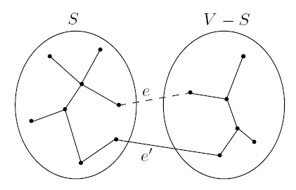
Cut Property: Assume edges X are part of an MST for G=(V,E). Pick any subset S for which X does not cross between S and V-S, and let e be the lightest edge across this partition. Then X ∪ {e} is part of some MST. – Why?
Assume edges X are part of a partial MST T (Inductive hypothesis)
If e is a part of T then done, so consider case where e is not part of T
Now add e to T, creating a cycle, meaning there must be another edge e' across the cut (S, V-S) (note that weight(e') ≥ weight(e))
Create T' by replacing e' with e: T' = T ∪ {e} – {e'}
T' is a tree since it is connected and still has |V|-1 edges
T' is an MST since:
weight(T') = weight(T) + w(e) – w(e')
both e and e' cross the cut (S, V-S)
by cut property e was the lightest edge across the cut
Therefore, w(e') = w(e) and T' is an MST
Thus, any (and only a) lightest edge across a cut will lead to an MST
Notes:
Not that great a proof

Slide 36
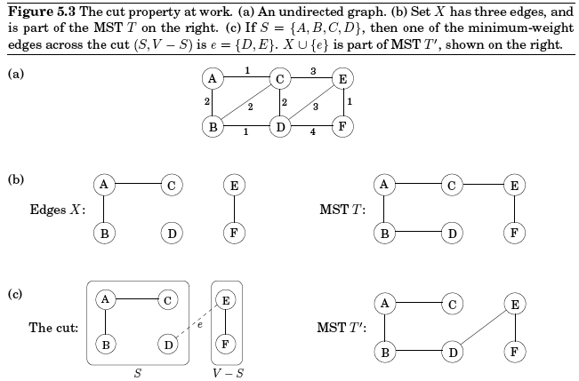
Cut Property
Which edge is e'?

Slide 37
Kruskal's Algorithm: Complexity and Implementation
Notes:
Sort is ElogE or equivalently ElogV since logV^2 = 2logV
can only be V-1 merges to be a tree, more would mean a cycle

Slide 38
Kruskal's Algorithm: Complexity and Implementation
Data structure will represent the state as a collection of disjoint sets where each set represents a connected component (sub-tree) of G
makeset(u): create a singleton set containing just u: |V| times
Sorting edges is O(|E|log|E|) (or O(|E|log|V|) since differs by a constant factor)
find(u): to which set does u belong?: 2|E| times
union(u,v): merge the sets containing u and v: |V|-1 times (why?)
Complexity is O(|E|log|E| + |E|×find_complexity + |V|×union_complexity)
Notes:
Sort is ElogE or equivalently ElogV
can only be V-1 merges to be a tree, more would mean a cycle

Slide 39
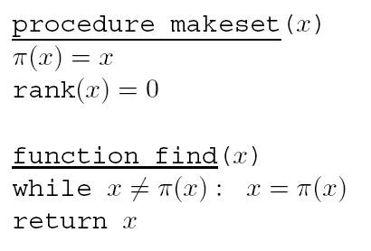
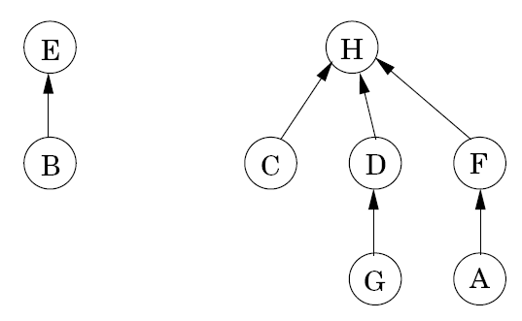
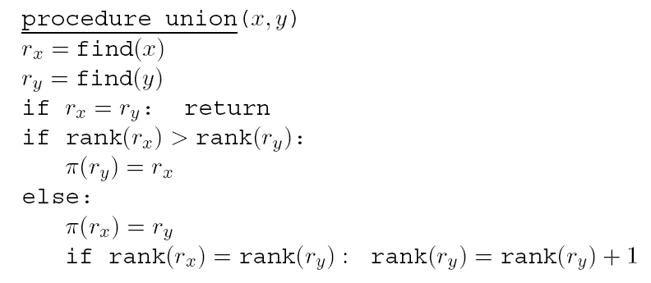
Directed Tree Representation of Disjoint Sets
Nodes are stored in an array (easy access) and have a pointer and a rank value
π(x) is a pointer to parent
if π(x) points to itself it is the root/name of the disjoint set
find(x) returns the unique root/name of the set
union(x,y) merges sets to which x and y belong and keeps the tree balanced so that the maximum depth of the tree representing the disjoint set is log|V|
rank(x) is the height of the sub-tree rooted at node x
makeset is O(1)
find and union complexity?
Notes:
Find and union are log|V|
Do example for each method using sets on right
rx means root x
note arity of the tree not-problematic because only follow links up (no sorting going down, etc). – thus the wider the better

Slide 40
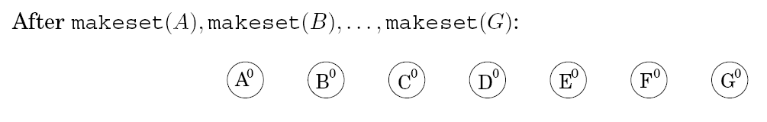
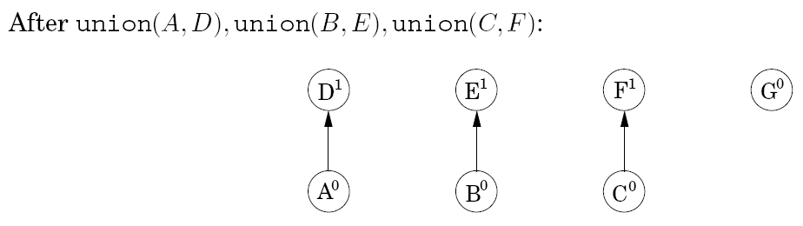
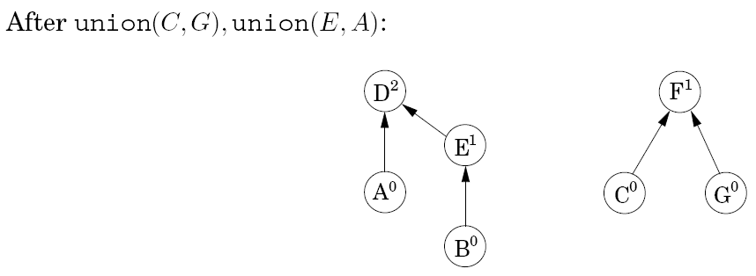
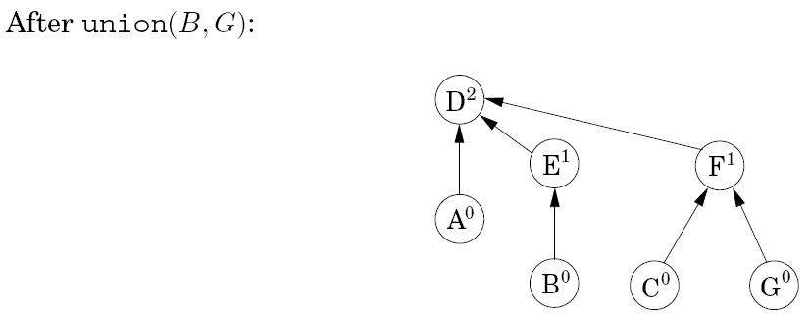

Slide 41
Kruskal Algorithm Complexity
O(|E|log|V|) for initially sorting the edges
Sort is actually O(|E|log|E|)
Note that for a dense graph |E| ≈ |V|²
But remember that logn² = 2logn so they only differ by a constant factor and thus Θ|E|log|V| = Θ(|E|log|E|)
O(|V|) for the initial makesets
O(|E|log|V|) for the iteration body including the find and union (merge) operations
Total complexity: O(|E|log|V|)

Slide 42
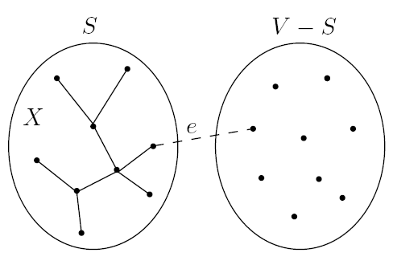
Prim's Algorithm
Any algorithm which follows the Cut Property can discover an MST for a graph G
Prim's algorithm differs from Kruskal's by growing S as a single tree
Intermediate set of edges X always forms one sub-tree
S is chosen to be the set of X’s vertices (the partial MST)
On each iteration, X grows by one edge
namely the lightest edge between a vertex in S and a vertex outside S.
The algorithm is basically Dijkstra's algorithm except that the key value for a node is the lightest incoming edge from S

Slide 43
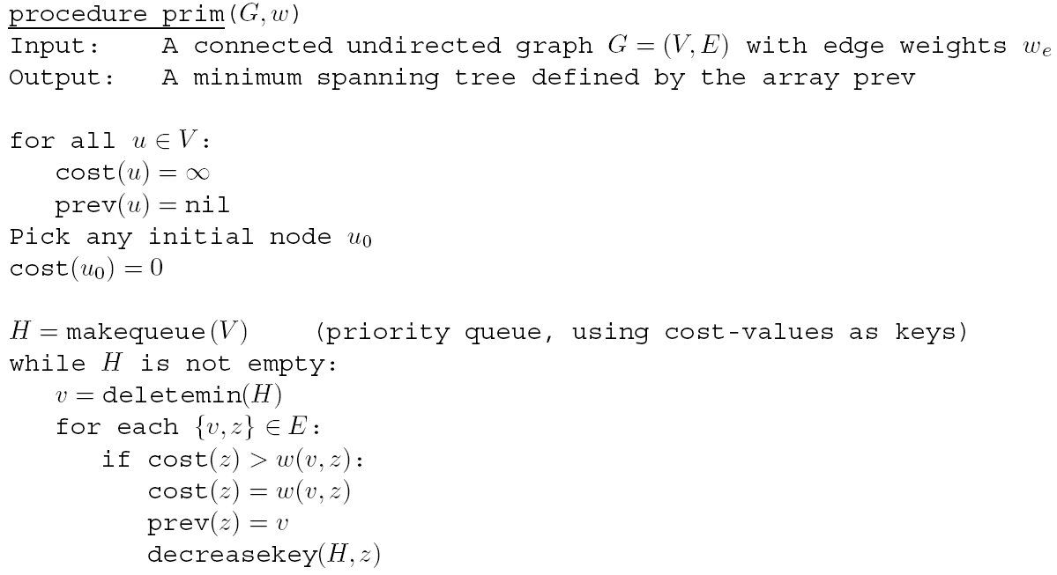
Prim's Algorithm
Decreasekey section does not sum path length, but just updates the key with the edge cost into the node
Same complexity values as Dijkstra's Algorithm
Notes:
Keeps shortest edge of any node currently in X to any node in V-X
Note bug in above alg, since there is no dequeued flag, prev pointers can get sent back wrongly to a node already removed from the queue

Slide 44
Prim’s Algorithm
Choose arbitrary starting vertex
1
2
1
2
3
S = {5}
1: ∞
2: ∞
3: ∞
4: ∞
5: 0
6: ∞
7: ∞
6
5
4
4
6
3
8
4
5
6
8
4
3
7
Notes:
Goal: Present Prim’s algorithm graphically in a manner similar to Kruskal’s algorithm.

Slide 45
Prim’s Algorithm
Choose arbitrary starting vertex
1
2
1
2
3
X :
S = {5}
1: ∞
2: 4
3: 5
4: 3
6: 8
7: 8
6
5
4
4
6
3
8
4
5
6
8
4
3
7
Notes:
Goal: Present Prim’s algorithm graphically in a manner similar to Kruskal’s algorithm. Initially, consider the light blue edges leaving 5.

Slide 46
Prim’s Algorithm
Pick shortest edge to leave S
1
2
1
2
3
X :
S = {5}
{4,5}
1: ∞
2: 4
3: 5
4: 3
6: 8
7: 8
6
5
4
4
6
3
8
4
5
6
8
4
3
7

Slide 47
Prim’s Algorithm
Add connected vertex to S
1
2
1
2
3
X :
S = {5}
{4,5}
S = {4,5}
1: ∞
2: 4
3: 5
4: 3
6: 8
7: 8
6
5
4
4
6
3
8
4
5
6
8
4
3
7

Slide 48
Prim’s Algorithm
Now choose shortest path from any
node in S – one on front of queue
1
2
1
2
3
X :
S = {5}
{4,5}
S = {4,5}
1: 4
2: 4
3: 5
6: 8
7: 4
6
5
4
4
6
3
8
4
5
6
8
4
3
7
Notes:
Now consider any of the blue edges leaving 4 or 5. Etc. as we add more vertices. Node 7 cost is decreased.

Slide 49
Prim’s Algorithm
Repeat until S = V
1
2
1
2
3
X :
S = {5}
{4,5}
S = {4,5}
2: 1
3: 5
6: 8
7: 4
6
5
4
4
6
{1,4}
S = {1,4,5}
3
8
4
5
6
8
4
3
7

Slide 50
Prim’s Algorithm
Repeat until S = V
1
2
1
2
3
X :
S = {5}
{4,5}
S = {4,5}
3: 2
6: 8
7: 4
6
5
4
4
6
{1,4}
S = {1,4,5}
3
8
{1,2}
S = {1,2,4,5}
4
5
6
8
4
3
7

Slide 51
Prim’s Algorithm
Repeat until S = V
1
2
1
2
3
X :
S = {5}
{4,5}
S = {4,5}
6: 6
7: 4
6
5
4
4
6
{1,4}
S = {1,4,5}
3
8
{1,2}
S = {1,2,4,5}
4
5
6
{2,3}
S = {1,2,3,4,5}
8
4
3
7

Slide 52
Prim’s Algorithm
Repeat until S = V
1
2
1
2
3
X :
S = {5}
{4,5}
S = {4,5}
6: 3
6
5
4
4
6
{1,4}
S = {1,4,5}
3
8
{1,2}
S = {1,2,4,5}
4
5
6
{2,3}
S = {1,2,3,4,5}
{4,7}
S = {1,2,3,4,5,7}
8
4
3
7

Slide 53
Prim’s Algorithm
Repeat until S = V
1
2
1
2
3
X :
S = {5}
{4,5}
S = {4,5}
6
5
4
4
6
{1,4}
S = {1,4,5}
3
8
{1,2}
S = {1,2,4,5}
4
5
6
{2,3}
S = {1,2,3,4,5}
{4,7}
S = {1,2,3,4,5,7}
8
4
3
{6,7}
S = {1,2,3,4,5,6,7}
7

